Slide 1

Fatal Police Shootings in the United States from 2015-2022 Team 7 Midterm Exploratory Data Analysis Alex Khater, Rajeev Koneru, Cora Martin

Slide 2

Data Set Information
In response to a severe lack of reporting within government sources, The Washington Post compiled a database of every fatal police shooting in the United States from 2015-2022. We are interested in exploring this data, specifically as it relates to differences between U.S. states and regions.
After accounting for null values, the data set we are working with has 6,574 observations. Below we have provided a sample row of the data:
Name | Date | Manner of Death | Armed | Age | Gender
Tim Elliot | 10/04/2022 | Shot | Gun | 53 | M
Race | City | State | Signs of Mental Illness | Threat Level | Flee
A | Shelton | WA | 1 | TRUE | Not fleeing
Body Camera | Longitude | Latitude | Is Geocoding Exact
FALSE | -123 | 47.2 | TRUE

Slide 3
SMART Research Question
Within our data set of 6,574 observations of police shootings from 2015 to 2022 in the United States, is there a correlation between the U.S. state of observation and whether a body camera was turned on during the shooting?
S
Variables that matter for our question: US state where the shooting took place and whether the police body camera was on or off
M
Statistical analysis used to identify a correlation between the two variables (correlation is easily measurable with data reshaping)
A
The amount of data is manageable with only 6,574 observations spanning over a seven-year period.
R
We may apply this research to state policy on body cameras during police work.
T
With three people working on this research, a couple of weeks are required to perform the data analysis.

Slide 4
RAJEEV START HERE

Slide 5
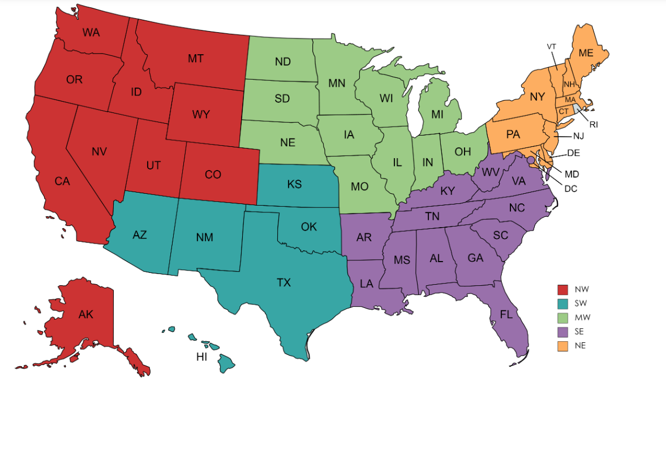
Reshaping Our Data for the SMART Q
Group Data and Variables by State to foster comparisons at the State level
Separated the Data into Regions for Graphical Display Purposes

